Slide 1



DEPARTMENT OF ELECTRONICS AND COMMUNICATION ENGINEERING
18ECP105L-MINOR PROJECT- III
PROJECT REVIEW
AUTOMATED HYGIENE MANAGEMENT SYSTEM FOR PUBLIC
RESTROOMS AND SEPTIC TANKS
PRESENTED BY:
GUIDED BY,
SUJITHA G 927622BEC220
SWATHI R 927622BEC226
SWETHA K 927622BEC227 VARSHINI S 927622BEC242
Dr.K.SHEIKDAVOOD,M.E.,Ph.D., Assistant Professor

Slide 2
OBJECTIVE
Automated hygiene system design
PIR sensors for restroom cleanliness
Odor control with scent dispensers
Automated flushing and cleaning cycles
High-pressure water jet cleaning
Reduced manual labor requirements
Enhanced sanitation and public health

Slide 3
ABSTRACT
This study proposes an automated hygiene management system for septic tanks and public toilets to enhance cleanliness and reduce manual effort. The system uses PIR sensors for occupancy detection, odor sensors to monitor air quality, and high-pressure water jets for cleaning. An aroma dispenser activates when odor levels exceed 15 PPM, with additional sprays and alerts for persistent odors, triggering a full cleaning cycle if necessary. Automatic flushing is initiated when no occupancy is detected, and septic tank odor levels are managed between 50-100 PPM with high-pressure drainage. This solution addresses issues like poor cleaning, odor control, and waste overflow, providing a cost-effective, efficient, and sustainable sanitation system.

Slide 4
INTRODUCTION
Public restrooms and septic tanks,odor, and overflow issues.
PIR sensors enable automated flushing and restroom monitoring
Odor sensors monitor air quality and trigger responses.
High-pressure jets ensure effective cleaning and waste disposal.
Manual intervention reduction
Resource efficiency
Sanitation improvement

Slide 5
LITERATURE SURVEY
Study/Project | Year | Objective | Methodology | Outcome | Relevance
High-Pressure Jet Cleaning (2017) | 2017 | Improve sewage cleaning efficiency. | High-pressure pumps for cleaning tanks. | Effective cleaning, less manual effort. | Relevant for septic tank maintenance.
Automated Restroom Management System | 2018 | Automate restroom cleaning and optimize water usage. | Used PIR sensors for occupancy and flushing. | Improved hygiene, reduced water wastage. | Supports automated flushing in restrooms.
IoT-Based Waste Management | 2019 | Automate waste collection. | IoT sensors for level detection and alerts. | Prevented overflow, optimized resources. | Enables real-time monitoring for tanks.
Odor Control in Public Spaces | 2020 | Monitor and control odor levels. | Used gas sensors and scent dispensers. | Enhanced air quality, reduced complaints. | Validates use of odor sensors and dispensers.
Public Toilet Maintenance System | 2021 | Ensure regular cleaning with minimal effort. | Sensor-based cleaning initiation. | Improved hygiene, reduced complaints. | Aligns with automated cleaning cycles.
Our Project | 2024 | Ensure hygiene in public restrooms and septic tanks. | Integrated sensors, jets, dispensers, IoT. | Improved hygiene, reduced manual work. | Combines multiple solutions innovatively.

Slide 6
EXISTING METHOD
Periodic maintenance by cleaning staff
Basic flushing systems without automation
Limited use of air fresheners for odor control
Dependence on manual waste removal
Inefficient septic tank monitoring methods

Slide 7
PROPOSED METHOD
PIR sensor-based occupancy detection
Automatic flushing mechanism
Odor monitoring with sensors
Scent dispenser for air quality
Septic tank odor level control
Maintenance alert system

Slide 8
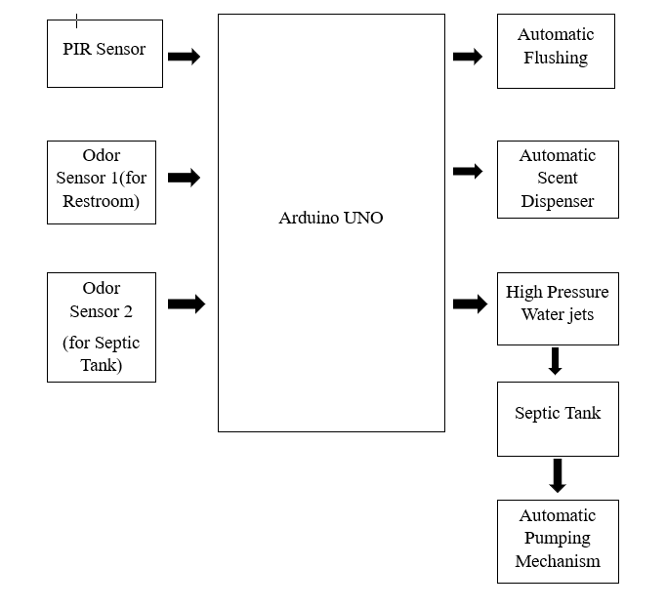
BLOCK DIAGRAM
Node MCU

Slide 9
RESULT & DISSCUSSION
Improved odor control mechanisms
Reduction in manual cleaning dependency
Consistent cleanliness standards achieved
Real-time monitoring and alerts
Improved public health and hygiene
Sustainable and cost-effective solution
Positive user feedback and adoption

Slide 10
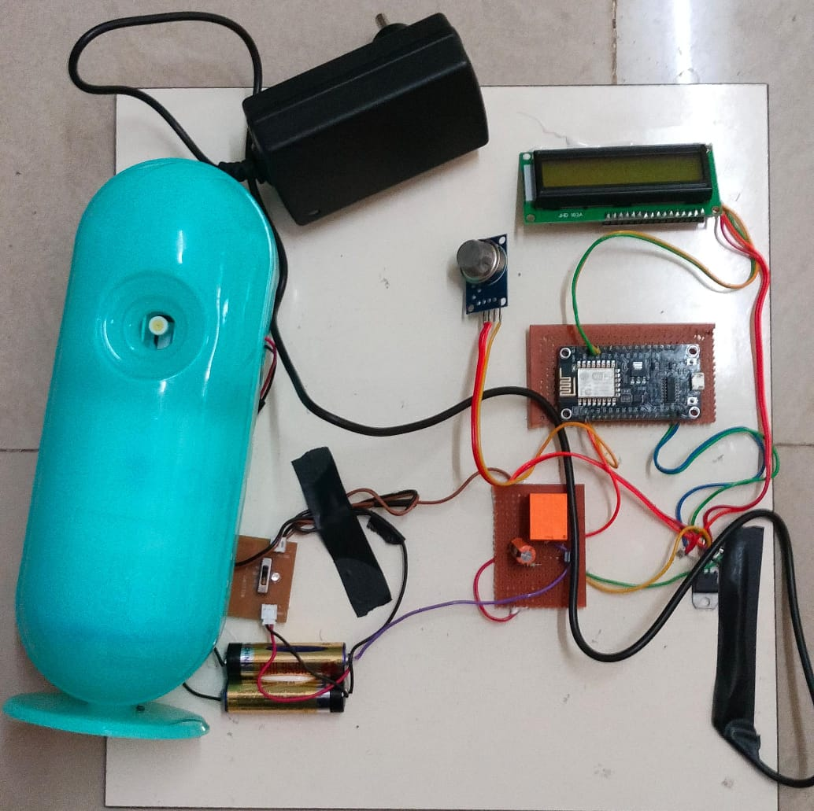
ODOR AND HYGIENE MONITORING SYSTEM PROTOTYPE

Slide 11
CONCLUSION
Automated hygiene management system
PIR sensors for occupancy detection
Odor sensors for air quality monitoring
Automated Scent dispensers for odor control
Regular odor level checks in septic tanks
Enhanced resource management and efficiency
Improved public health and sanitation standards

Slide 12
TOOL USED
BLINKER IOT
Blinker IoT enables real-time monitoring of odor levels, restroom occupancy, and septic tank conditions. It triggers actions like scent dispensing and flushing based on sensor data. The platform ensures efficient, automated sanitation management with minimal manual intervention.

Slide 13
ADVANTAGES
Enhanced Hygiene
Odor Control
Reduced Manual Effort
Public Health Improvement
Sustainability
Real-Time Monitoring

Slide 14
APPLICATIONS
Public Restrooms
Hospitals and Clinics
Educational Institutions
Transportation Hubs
Corporate Offices
Hotels and Restaurants
Event Venues

Slide 15
REFERENCES
Cheng, X., & Liu, Q. (2020). "IoT-based real-time odor detection system for public toilets." International Journal of Environmental Research and Public Health, 17(12), 4371. https://doi.org/10.3390/ijerph17124371
Lee, S., & Kim, D. (2021). "Design of an automatic hygiene monitoring system based on IoT for public restrooms." Sensors, 21(10), 3415. https://doi.org/10.3390/s21103415
Gao, W., & Li, Y. (2018). "High-pressure cleaning systems in wastewater management." Environmental Science and Technology, 52(4), 1212-1218. https://doi.org/10.1021/acs.est.7b05901
Bai, W., & Li, X. (2019). "Water-saving technologies for smart toilets." Water, 11(3), 490. https://doi.org/10.3390/w11030490
He, H., & Wang, L. (2020). "Internet of Things-based smart sanitation management for public facilities." Sustainability, 12(2), 537. https://doi.org/10.3390/su12020537

Slide 16
PROJECT OUTCOME
The outcome of this project is that it has been successfully formulated and submitted as a research paper for presentation at the International Conference on Multi-Agent Systems for Collaborative Intelligence (ICMSCI 2025), organized by Surya Engineering College, Erode, Tamil Nadu, India, scheduled to take place on January 20–22, 2025.This submission demonstrates the research's significance in the domain of advanced computing and collaborative intelligence. The paper adheres to the IEEE format and aligns with the conference’s vision of advancing knowledge in computing, communication, and informatics. Through this initiative, the research team contributes to the academic and professional discourse in these critical fields.We anticipate that our research will provide valuable insights and foster future collaborations within the community

Slide 17
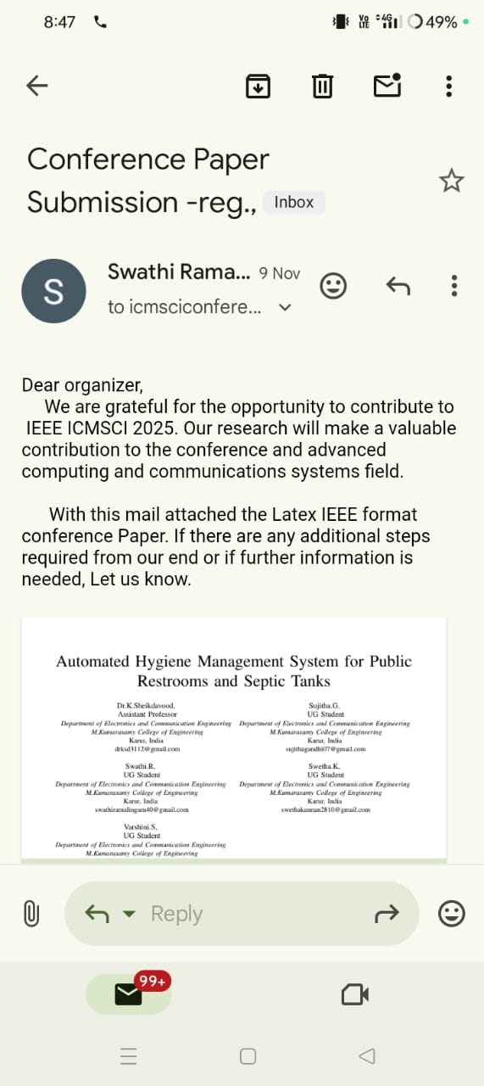
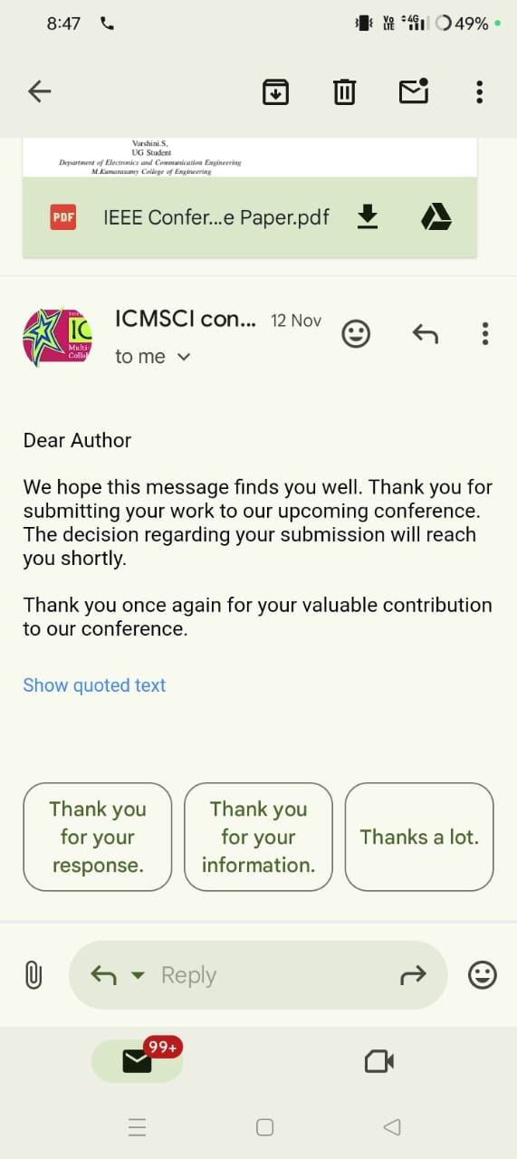
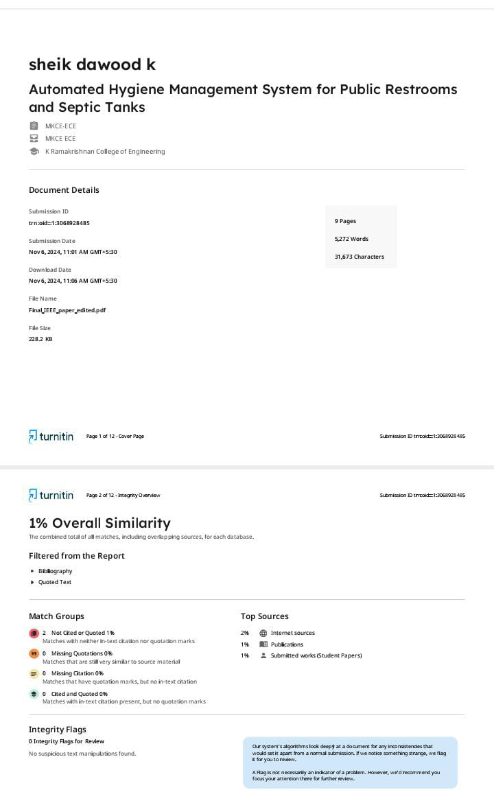

Slide 18


